Slide 1
Writing to Guide - Procedures
Chapter Three
Part Two
Fatima M.AbuHjeela

Slide 2
Writing to Guide
Procedure result directly from your putting the functions of the program into usable set of steps that do the user’s work.
When the user follows a procedure , he or she is actually at work with all urgency, importance, anxiety and stress of work situation
In procedure , you are an assistance rather than a teacher.
The reader of the procedure needs to know :what key to press, what reports and screen will look like, how to get out of trouble,…etc.
Fatima M.AbuHjeela

Slide 3
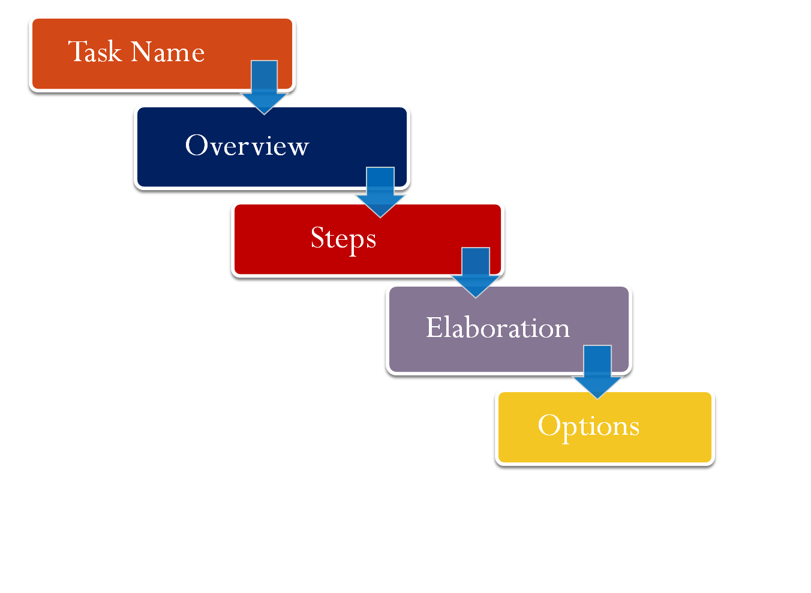
How Does a Procedure Work
Screens
Fatima M.AbuHjeela

Slide 4
Task Name
Identifies the program function in performance oriented language.
Task name should describe what job the user perform ,not what functions he or she uses.
Example :
  Weak ( Program-Oriented Task Name)
  Using the print function. Using the open command.
  Strong (Task-Oriented Task Name)
  Printing a card , opening a file .

Slide 5
Overview
It serves as an introduction , and orient the reader to the use of the procedure .
It is a bridge between a the operation of the program and the action the user want to accomplish with it.
To write overviews well you need to analyze not just what steps the user needs to follow, but why.
What you say in the introduction gives some degree of assurance that the user, when faced with a decision in the completion of a task ,will make the right decision.
Fatima M.AbuHjeela

Slide 6
Overview
Example:
Task Name : Changing Default settings
Introduction:
“ Picture publisher lets you save defaults in the tool ribbons and in some dialog boxes .you will find these features extremely helpful when working with picture publisher. “
Fatima M.AbuHjeela

Slide 7
Steps
It make up the most important part of the procedure ,because they embody the segment of time during which the procedure directs the user’s activity.
Steps give the user:
  Tools to use.
  Actions to take with tool.
    Example :
    step 1: Using the mouse ,select the open option in file menu to open an existing file .
Steps should always occur in chronological order, to ensure that the user will not get lost .
Use numbers instead of bullets for steps .
Fatima M.AbuHjeela

Slide 8
Steps
  Put the smaller action in prose format and doesn’t number them.
  Example:
  Weak :
  Step1: Choose an action from the group dialog box.
  1. select a name for the group.
  2. select a directory name for the group.
  3. set the access code .
  Strong :
  Step1: Choose an action from the group dialog box.
    Once you have opened the group dialog box , you need to select a name for the group , then set the access code to either open or restricted
Fatima M.AbuHjeela

Slide 9
Steps
  If the user needs to perform an action and that action has some result, then the action should appear as a numbered step.
  Example:
  Weak :
  1. Choose open from the File menu.
  2. A new document appears.
  3. Choose font from the format menu.
  4. The font dialog box appears.
  Strong :
  1. Choose open from the File menu.
  A new document appears.
  3. Choose font from the format menu.
  The font dialog box appears.
Fatima M.AbuHjeela

Slide 10
Elaboration
  It explain the steps, commenting on them as they get performed .
  In elaboration you share the following kinds of advice with your users:
    Possible mistakes and how to avoid them
    How to perform procedure efficiently.
    Alternative such as keystrokes, toolbars ,or function keys.
    Definitions of terms.
    Ways to tell if a step has been performed correctly.
    Where else to look for additional information.
  Try to use the active voice to refer to the program
    Example : Market Master will display the control panel .
Fatima M.AbuHjeela

Slide 11
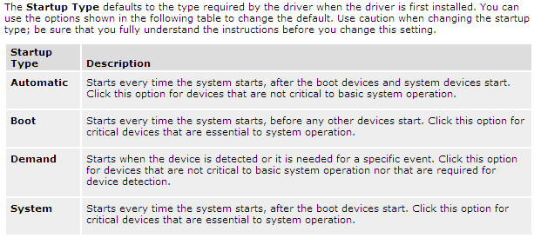
Options
  Don’t list options as steps .
  Use table to include a list of options ,because it save time and space .
Fatima M.AbuHjeela

Slide 12
Screens
Use the screens to do the following :
  Give an overview of the main panel of an interface .
  Show the partial result of procedure to help user keep on track.
  Show the final result of the procedure to let the user know where the procedure end .
  Show the dialog box where the user has to make choices .
  Show toolbar indicating which tools the user needs .
  Show menus indicating what command the user needs .
Fatima M.AbuHjeela

Slide 13
Practice /Problem Solving
Write a basic procedure .
Fix a procedure , and rewrite it in a way that make it more logical and consistence .
Rewrite prose format into standard format .
Fatima M.AbuHjeela

